Slide 1
Unit1: Introduction
Concept of Micro Economics
-Micro economics is made up of two words as micro and economics
-The word micro is derived from the Greek word mikros meaning small.
-So, micro economics deals and studies about small and individual parts and units of the economy.
It is the worm’s eye view of the economy

Slide 2
-According to Kenneth Edward Boulding, Micro economics is the study of particular firms, particular households, individual prices, wages, income, individual industries, and particular prices’. The scope of Micro Economics are: -Theory of demand and supply -Theory of production -Theory of product pricing -Theory of factor pricing Theory of economic welfare

Slide 3
Types of Micro Economics
Micro Economics is divided into three types as:
1. Micro static
2. Comparative Micro static
3. Micro dynamics
Micro static
It is state where the individual demand and individual supply are equal and an equilibrium position is maintained.

Slide 4
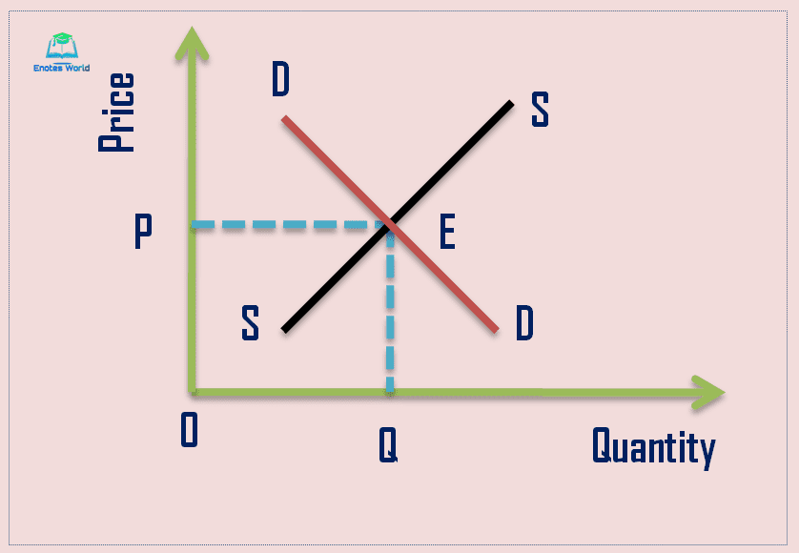
The Micro static can be shown in a diagram as:

Slide 5
In the above figure, DD is the individual demand curve and SS is the supply curve. The DD and SS curves are equal at point E. This the equilibrium and the static point of the individual market.

Slide 6
2. Comparative micro static
Comparative static makes a comparison between two or more equilibriums or static points in the market.
It compares the new and old equilibrium points of the same goods at different prices or quantities.
It is a still picture of an individual market.
It can be shown in a diagram as:

Slide 7
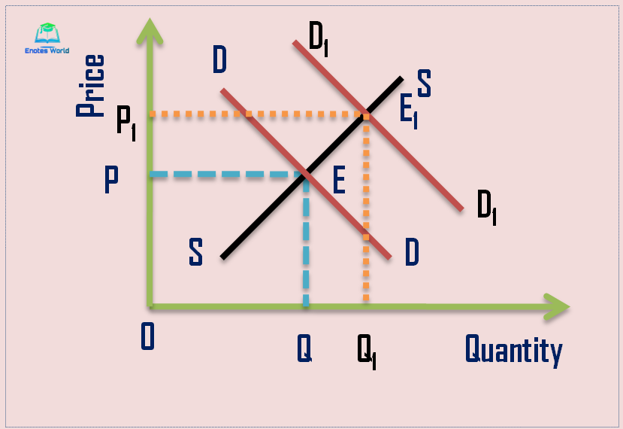

Slide 8
In the figure, DD is the initial demand curve and ss is the supply curve.
The DD and SS curves are equal at point E. This is the initial equilibrium or the static point.
With the shift in demand curve from DD to D1D1, at constant supply curve, a new equilibrium point is reached at E1.
Comparative Micro static makes a comparison in price, quantity or other areas between the two equilibriums or static points.

Slide 9
3. Micro dynamics.
Micro dynamics is a motion picture whereby it analyses the processes, changes and the path that occurred in between the two equilibrium points.
It explains the changes how it moves from the initial equilibrium to a new one.
It can be shown in a diagram as:

Slide 10
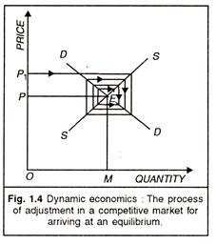

Slide 11
-In the diagram, E is the initial equilibrium point, where the aggregate demand and aggregate supply are equal.
-When the demand increases, the demand curve shifts from DD to D1D1 at the constant aggregate supply.
-As a result, the new equilibrium will shift upward to E.
-Micro dynamics analyses the path and the process in between the E and E1 equilibriums

Slide 12
Concept of Macro economics
-Macroeconomics is made up of two words of Macro and Economics.
-The word Macro is derived from the Greek word Makros meaning large.
-Macro economics deals with large parts and about the economy in totality and as a whole.
It is the bird’s eye- view of the economy

Slide 13
According to Kenneth Edward Boulding, ‘Macro Economics deals not with individual quantities as such, but with aggregate of these quantities, not with individual income but with national income, not with individual price but with price level, not with individual output but with national output’.

Slide 14
The scope of Macro Economics are:
-Theory of income and employment
-Theory of money and price level
-Theory of public finance
-Theory of economic growth
Theory of international trade and business fluctuations
-Macro economic policies

Slide 15
Types of Macro Economics
Macro Economics can be divided into as
Macro Static
Comparative Macro Static
Macro Dynamics
Macro static
-It is a situation of equilibrium in the economy where the aggregate demand is equal to aggregate supply

Slide 16
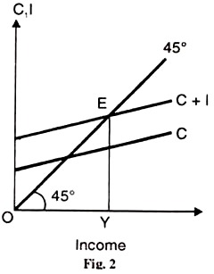

Slide 17
In the diagram OY is the aggregate supply curve and C+I is the aggregate demand curve.
The AD and AS curves are equal at point E and it is the equilibrium and the Macro static point of the economy.
Comparative Macro Static
Comparative Macro static makes a comparison between two or more equilibriums or static points in the economy.
It is the still picture of the economy.

Slide 18
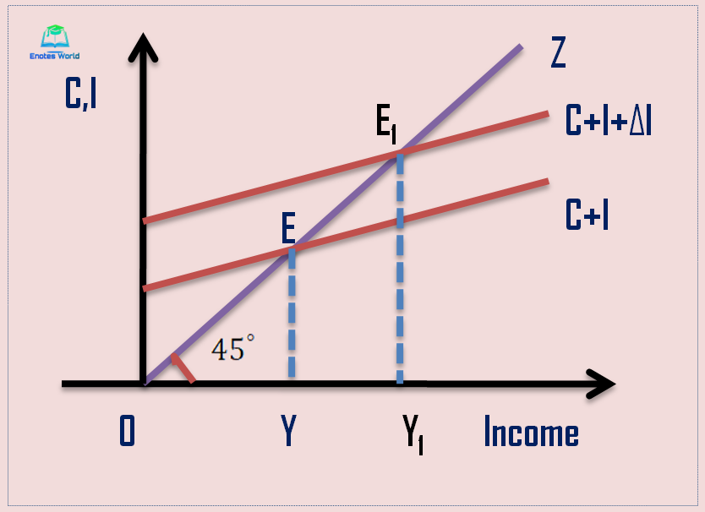

Slide 19
-In the diagram C+I is the initial aggregate demand curve and OZ is the aggregate supply curve.
-The AD and AS curves are equal at equal at point E and it is the initial equilibrium and static point in the economy.
-When the aggregate demand increases to
-C+I +∆I at the same AS curve, a new equilibrium is reached at E.

Slide 20
Comparative Macro Static makes a comparison between these initial and the new equilibrium and static points in the economy.
Macro Dynamics
Macro dynamics describes the process and the path followed in moving from the initial equilibrium to the new equilibrium.
- It is the motion picture of the economy.

Slide 21
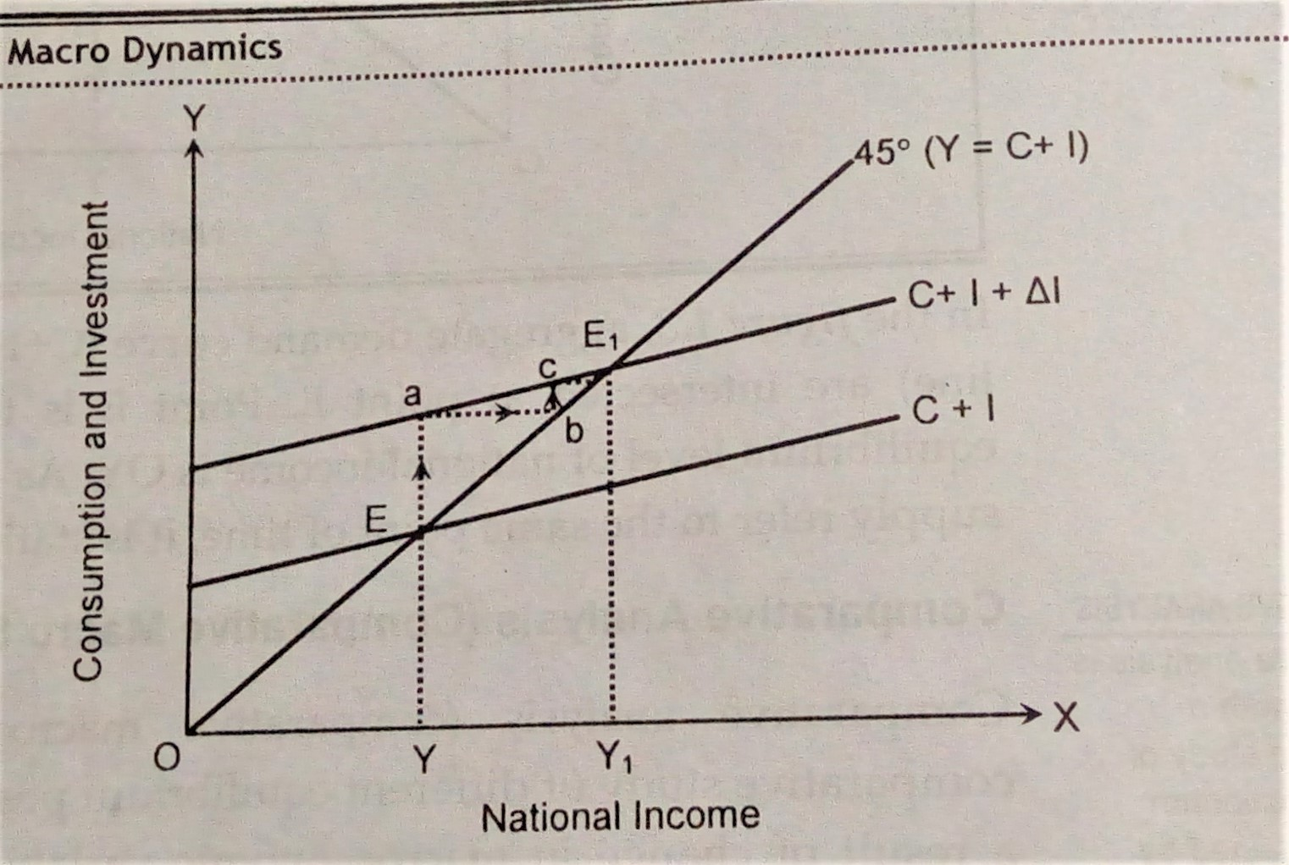

Slide 22
-In the diagram, E is the initial equilibrium where AD = AS
-With increase in investment, the AD curve shifts to C+ I + ∆I
-This will shift the equilibrium to E1.
-Macro dynamics studies the path and the process taken in moving from E to E1 equilibriums.

Slide 23
Differences between Micro and Macro Economics
S.N | Micro Economics | Macro Economics
1 | The word Micro has been derived from the Greek word Mikros meaning small | The word Macro has been derived from the Greek word Makros meaning large
2 | It deals and studies about small and individual units | It deals and studies about large parts and about the economy as a whole
3 | Its area of study and scope includes individual consumers, households, demand supply, firm, individual price, factor pricing, etc. | Its scope includes, national income, national output, aggregate demand and supply, international trade, public finance, economic growth and development, etc.
4 | Its objective is to maximize satisfaction and profit with the efficient allocation of resources | Its objective is to make faster economic growth and development, social welfare with the efficient and best use of resources
5 | It is also called Price Theory | It is also called the Theory of Output and Employment
6 | It is the study of partial equilibrium analysis as other things remaining the same | It is the study of general equilibrium analysis
7 | It is suitable for study the problems at the individual and unit level | It is suitable to study the problems of the economy as a whole

Slide 24
Goals of Macro Economics
-The Macro economic goals are set by the government to control, regulate and manipulate the macro economic variables and achieve the pre-determined macro economic goals:
-The main Macro economic goals are as follows:
Economic growth
Maintaining and achieving a high economic growth rate is a top necessity and the priority of all countries, rich or poor.

Slide 25
2. High rate of employment
-Maintaining a high rate of employment and reducing the unemployment is a top and a necessity goal of all governments, rich or poor for development and prosperity.
3. Price stability
-To keep the price stable, avoiding the fluctuations of inflation and deflation is one of the main goals of the government. In order to do so, the government adopts monetary and fiscal policy.

Slide 26
4. Economic equity -This is to ensure equity in the distribution of resources or income and reduce the inequality gap between the rich and poor. This will promote economic well-being of people.
5. Stabilizing Balance of Payments
-Balance of payments is the overall economic transaction of a country with other countries.
-The goal of all governments will be to stabilize the BOP situation , increasing the exports and reducing the imports of the country.

Slide 27
Instruments of Macro Economics
The instruments of macro economics are the tools that are used in Macro Economics in order to fulfill and attain the macro economic goals.
The instruments of Macro Economic can be broadly divided into two as:
Monetary Policy
Fiscal policy

Slide 28
Monetary Policy is concerned with the monetary system of the country. These are the policy measures adopted by the Central Bank to regulate and influence the money in order to stabilize the prices.
According to Edward Shapiro, ‘ Monetary Policy is the exercise of Central Bank’s control over the money supply as an instrument for achieving the objectives of economic policy’.
-Monetary policy can be expansionary and contractionary as according to the availability of inflation or deflation in the economy.
The instruments of monetary policy can be broadly divided into two types as
Quantitative method
Qualitative method

Slide 29
The quantitative methods are meant to influence the availability of credit in the economy through commercial policy
-The main quantitative methods of monetary policy are:
-Bank rate policy
-Open market operations
-Cash reserve ratio

Slide 30
Bank rate: It is the minimum lending rate which Central Bank charges to Commercial banks on the loans advanced to commercial banks, government securities or bills of exchanges, etc.
During inflation, the Central bank increases the bank rates. This will compel the commercial banks also to increases the interest rates on the loans advanced.
During deflation, the Central Bank decreases the bank rate and in turn will also reduce their interest rates.

Slide 31
-Open market operations: It is the buying and selling of government securities by the Central Bank in the open market as according to the necessity.
-During inflation, the Central Bank sells securities in the market which is bought by people and institutions and help reduce the money in the economy.
But during deflation, the Central Bank will buy the government securities in the open market from people and institutions and help to increase the money supply.

Slide 32
Cash reserve Ratio: It is the minimum and compulsory cash reserve rate which all banks need to keep in the Central Bank.
During inflation, the Central Bank will increase the cash reserve ratio.
This will decrease the credit creation capacity of the commercial banks which will decrease the money supply into the economy..
During deflation, the Central Bank will decrease the cash reserve ratio.
This will increase the credit creation capacity of the commercial banks which will increase the money supply into the economy.

Slide 33
2. Qualitative control -The qualitative control aims at regulating being selective in the allocation and advancing of credit.
The main qualitative controls are:
Regulation of margin requirement
Regulation of consumer’s credit
Credit rationing
Direct action
Moral suasion
Publicity

Slide 34
i. Regulation of consumer’s credit -It is the increase or decrease in the down cash payment in the purchase of expensive durable goods.
ii. Regulation of margin requirement
-Margin requirement is the difference between the value of securities and the amount of loans advanced by commercial banks.
-This margin requirement will be increased or decreases by the Central bank as according to the money supply in the economy.

Slide 35
iii. Credit rationing -It is the control of credit creation of commercial banks by Central Bank by limiting in certain percentage or amount and even in sectors
iv. Direct action
-It refers to the directives issued by Central Bank to the commercial banks to regulate their investments and interest.
-The Central Bank may take direct action against any individual banks too , if it does not comply with its directives.

Slide 36
v. Moral suasion -It is request or suggestion made by the Central Bank to the commercial banks by holding discussions, meetings about the need of the adoption of the said monetary policy.
vi. Publicity
The Central bank may express its views about the monetary or fiscal and banking policies through different mass media
It can also publish its periodic journals and make its policies public.

Slide 37
2. Fiscal Policy It refers to the policy adopted by the government regulating the government expenditures, public borrowings and taxes in order to stabilize the economy.
According to Arthur Smithies, Fiscal policy refers to ‘ a policy under which the government uses its expenditure and revenue programmes to produce desirable effects and avoid undesirable effects on the national production and employment’.
The main instruments of fiscal policy are:
-Budget -Public revenue
-Public expenditure -Public debt

Slide 38
1. Budget -It is estimated statements of the revenue and expenditures of the government for the coming fiscal year.
Budget can be :
-Balanced budget: When the income of the government is equal to its expenditure.
-Deficit budget : When the expenditure of the government is more than its income
-Surplus budget: When the income of the government is more than its expenditure.
-During inflation, the government should make a surplus budget and during deflation, a deficit budget should be made to stabilize the economy.

Slide 39
2.Public Expenditure It is the expenses made by the government for the welfare of the people and the development of the country in any fiscal year.
-Public expenditure can be
-Regular/ maintenance/current expenditure
Developmental/ capital /investment expenditure.
During inflation, the government should reduce all types of government expenditure and during deflation it should increase the expenditures.
3. Public revenue
Public revenue refers to the income earned by the government from different sources

Slide 40
There are mainly three sources of government revenue as: -Tax sources -Non-tax sources and -Foreign grants -During inflation, the government should increase internal borrowings but decrease external borrowings and during deflation, the internal borrowing should be reduced but external borrowings should be increased.
4. Public debt
-Public debt refers to the amount borrowed by the government from inside or outside the country to fulfill its deficit budget.
Public debt can be
-Internal sources: It can market borrowings and non-market borrowings
-External sources: It can be bilateral and multi-lateral borrowings

